Slide 1
MMD Consultants
Jhony Blanco, Satya Deep Tekumudi, Rabin Burlakoti, Malitha Salpadoru

Slide 2
Brand
Time
Our Focus
Performance

Slide 3
Our First Client
Bukralia Enterprises:
Wants to create a media company focusing on youtube.
Business Questions:
What types of videos trend better?
Do positive videos trend better than negative videos?
What is the best time to publish a video?
How quickly will a certain video trend?
What are characteristics of a trending video?

Slide 4
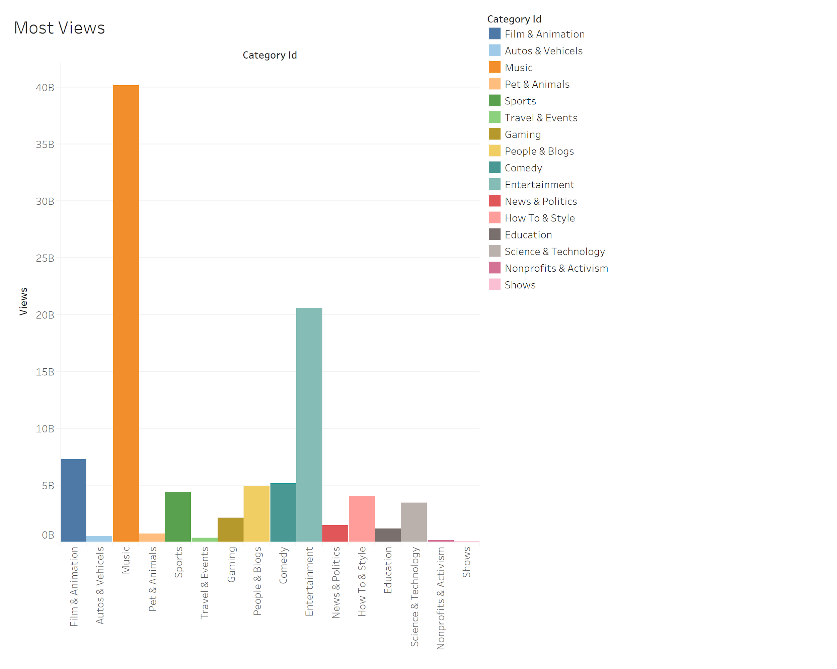
G
E
N
R
E

Slide 5
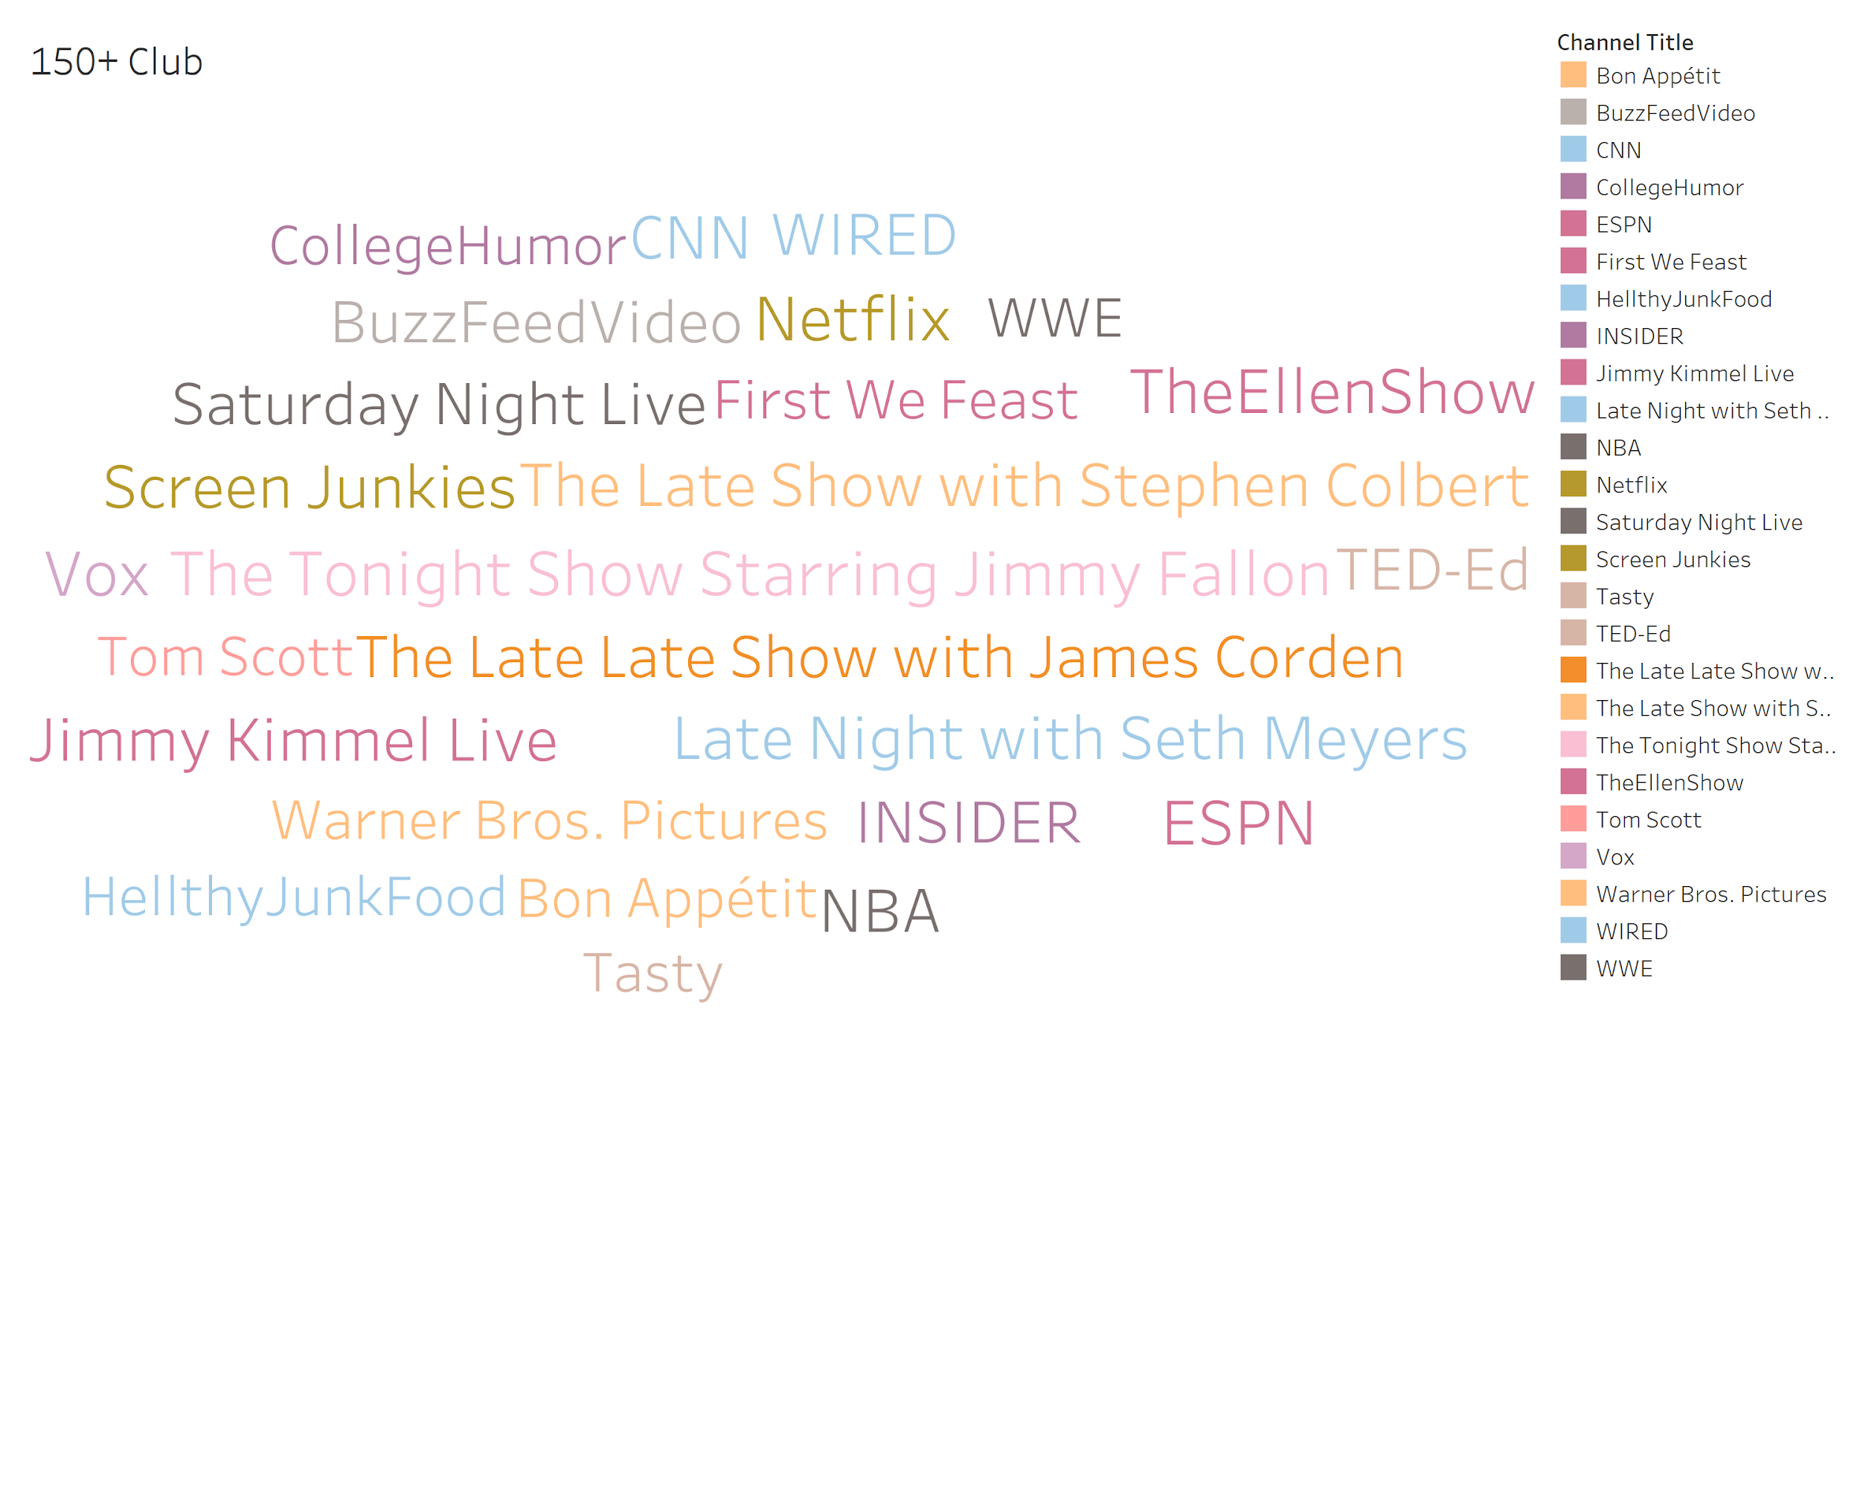
C
H
A
N
N
E
L

Slide 6
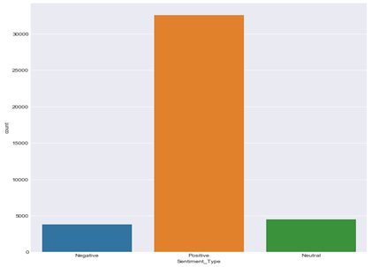
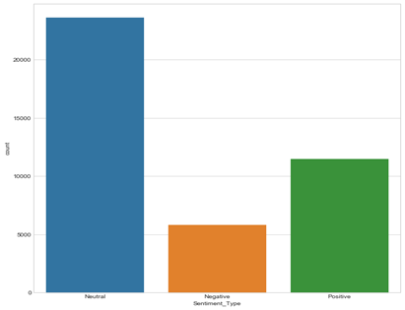
Sentiment Analysis
Video Description
Video Title

Slide 7
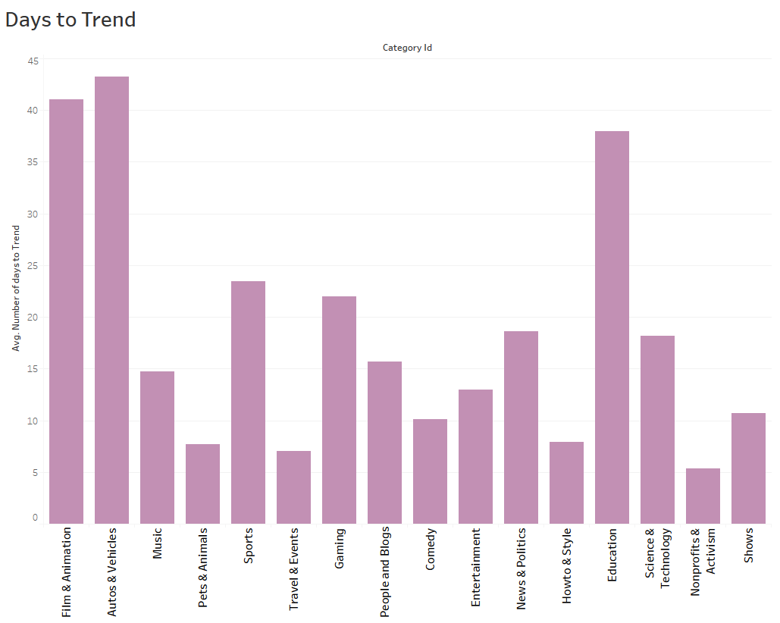
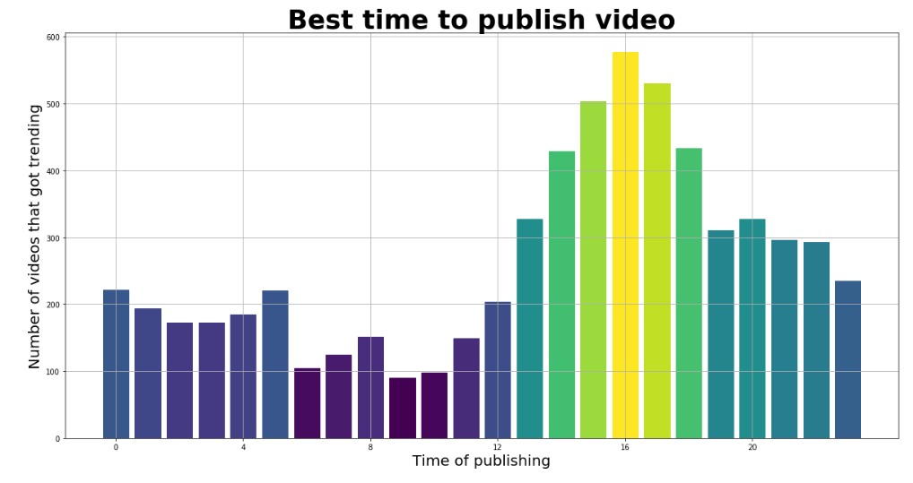
Time
Days until you trend
Times with most uploads

Slide 8
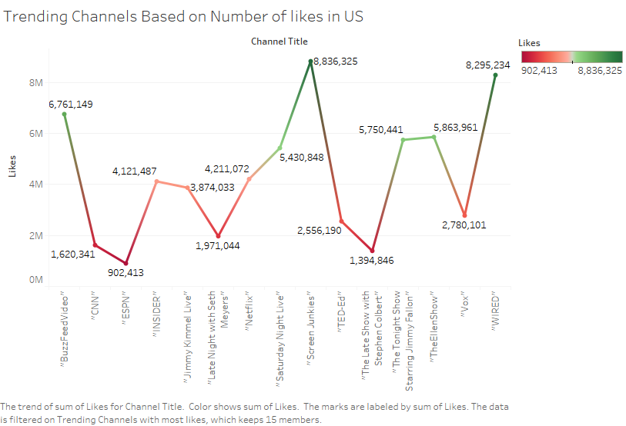
Channels vs Likes

Slide 9
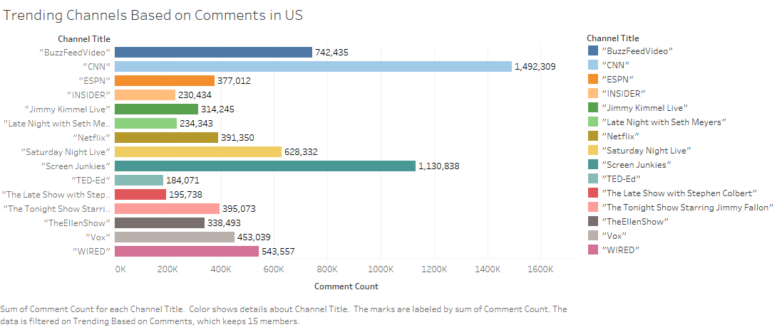
Channels vs Comments

Slide 10
Maverick Media Data Consultants
Provide real solutions
Give real-time performance analytics
Provide advice and support for media deployment
Give you insights on time and resource allocation

Slide 11
Questions?

